Slide 1






Capstone Project
Lets make Student Life Easier
SAPNA TARE

Slide 2




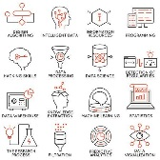


Agenda
Challenge: Students staying in metro cities having Longer commute problem
Solution: XYZ company has to figure out all the neighborhood locations where top universities are exists and start their business around.
Benefit More Revenue and Students get quality time for studies and other things.
Tools and Technologies
Questions ….?

Slide 3


Find the Universities neighborhood
The Challenge
The problem we aim to analyze the Universities locations across the USA and find the best place for our students to stay and make their life easier
How will you kill this challenge…. ? What is the solution ?

Slide 4

SOLUTION
CALL ME!
We could harness the power of machine learning to target the Universities and find the neighborhood to construct student housing.

Slide 5
Implementation
The flow below depicts the high level approach we will pursue to finding a solution to this business problem using Foursquare API to find the venues.
Business Problem ->Data Collection and Analysis ->
Methodology ->Results->Discussion-> Conclusion

Slide 6

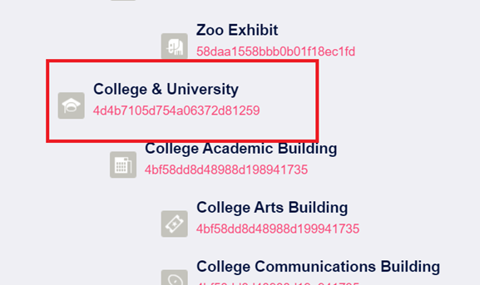
Data Preparation
For this project we need the following Data
Most machine learning algorithms require data to be formatted in a very specific way, so datasets generally require some amount of preparation before they can yield useful insights.
Data sources :-
Explore Venue using Category ID -
https//developer.foursquare.com/docs/resources/category-ID
https://api.foursquare.com/v2/venues/explore

Slide 7

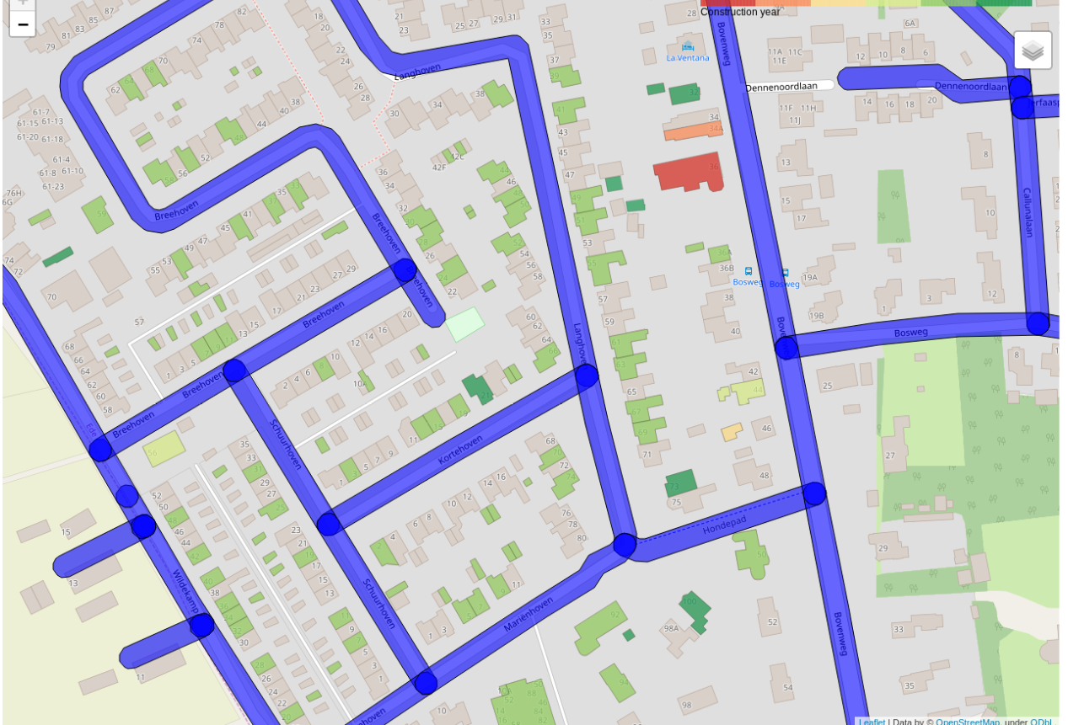

Methodology and Visualization
FourseSqure API- Get Venues from API
Folium :-folium makes it easy to visualize data that's been manipulated in Python on an interactive leaflet map.
GepPy :-To get coordinates latitude and longitude

Slide 8

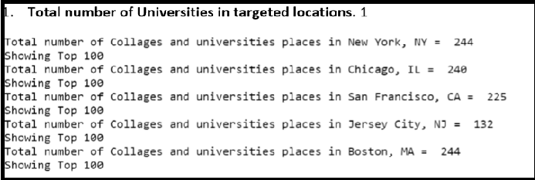
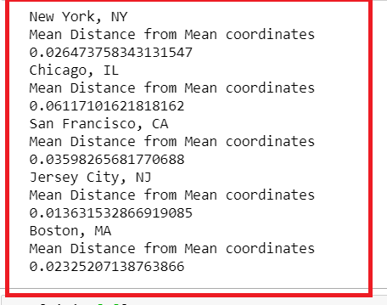
Methodology and Visualization -Contd

Slide 9
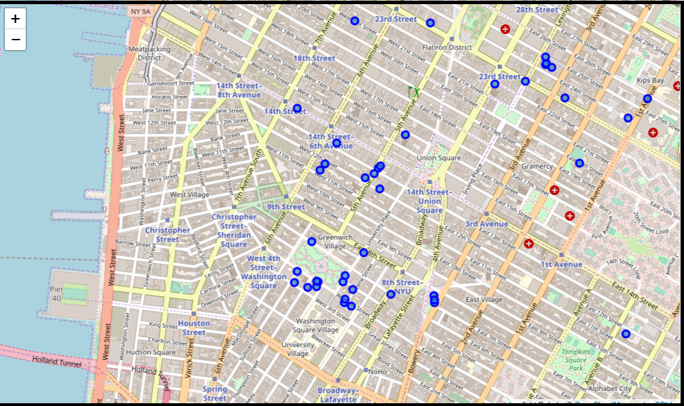
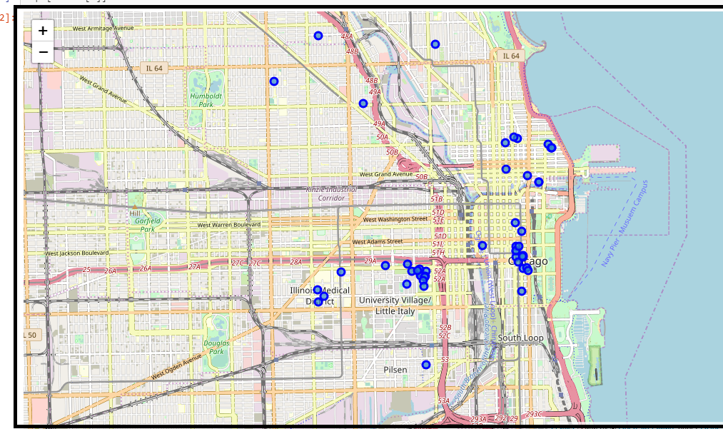
Result and Visualization
New York:
Chicago,IL

Slide 10
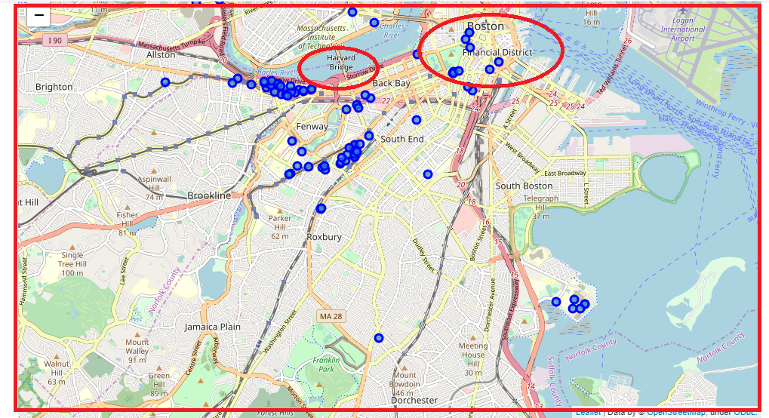
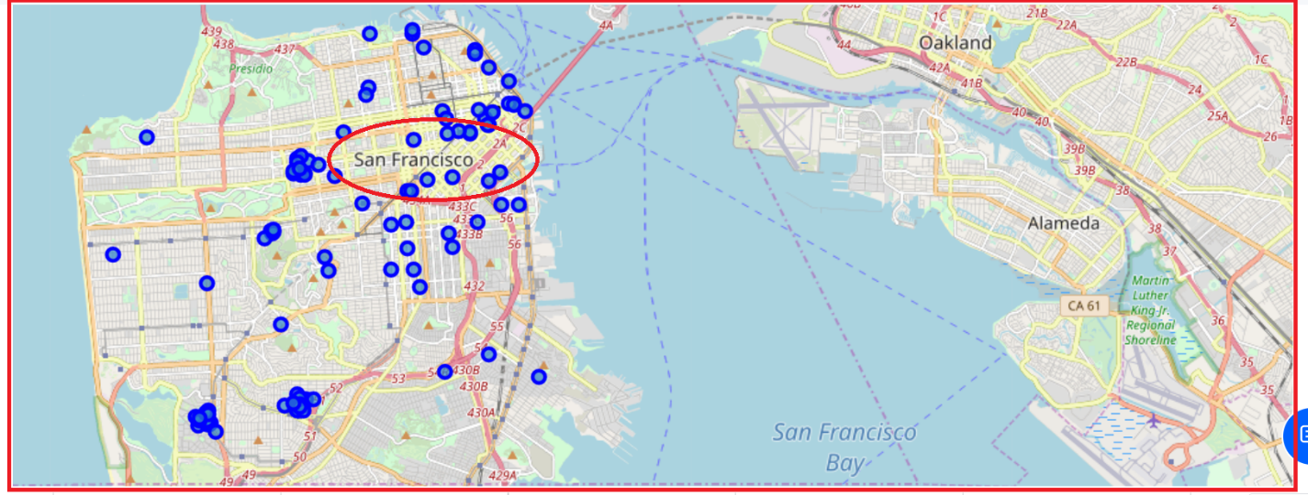
Result and Visualization
San Francisco, LA
Bostan,MA

Slide 11
Result and Visualization
Jercy City ,NJ

Slide 12
Discussion
Observation 1: - Based on the above research for XYZ company. I conclude that company should target first New York and Boston have more universities and colleges than other cities. In such city’s student life would be easier in terms of commute/transport. That is good idea to construct dorms and off campus in such locations. and We get more clarity using Data Visualization.
Observation 2: - I noticed in the figure is that there is a really far away universities in San Francisco that is probably giving it a higher Mean. So, I checked what if I removed it, it would not harm anyone. The new MDMC was: 0.0519953, putting it one place up on the list replacing Chicago, IL. One consideration to do further work on is to move the location of the Foursquare API query until we get all the universities places in each city and do the calculations again.

Slide 13
Conclusion
Conclusion – XYZ company should target first New York and Boston because of more universities and colleges located than other cities. In such city’s student life would be easier in terms of commute/transport. That is good idea to construct dorms and off campus. This decision is profitable to company too.

Slide 14
Thank You

